Slide 1

Interest Point Detection
Lecture-4

Slide 2

Contents
Harris Corner Detector
Sum of Squares Differences (SSD)
Corrleation
Taylor Series
Eigen Vectors and Eigen Values
Invariance and co-variance

Slide 3
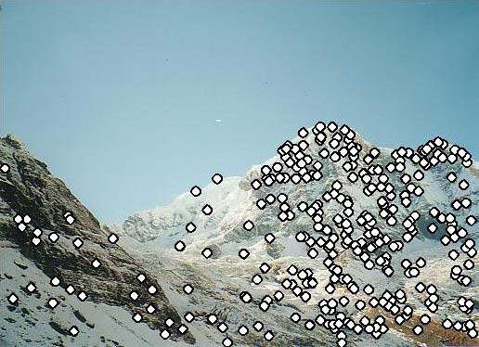
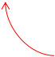


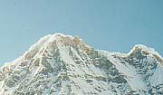
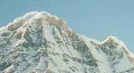
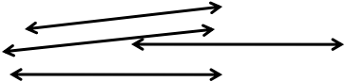
Local features: main components
1)Detection: Identify the
interest points
2)Description :Extract feature
vector descriptor surrounding
each interest point.
x₁=[x₁⁽¹⁾,😐,x_{d}⁽¹⁾]
3)Matching: Determine
correspondence between
x₂=[x₁⁽²⁾,😐,x_{d}⁽²⁾]
descriptors in two views

Slide 4
Interest Point
In computer vision, an interest point, refers to a distinct and identifiable location within an image that is invariant to various transformations such as rotation, scaling, and illumination changes.
An interest point is also known as a feature point or keypoint.

Slide 5
Interest Point
Interest Points represent a significant change in the image content, such as corners, edges, or other strong local features that can be easily detected and reliably matched in different images of the same scene.

Slide 6

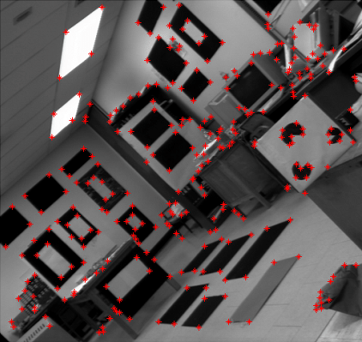
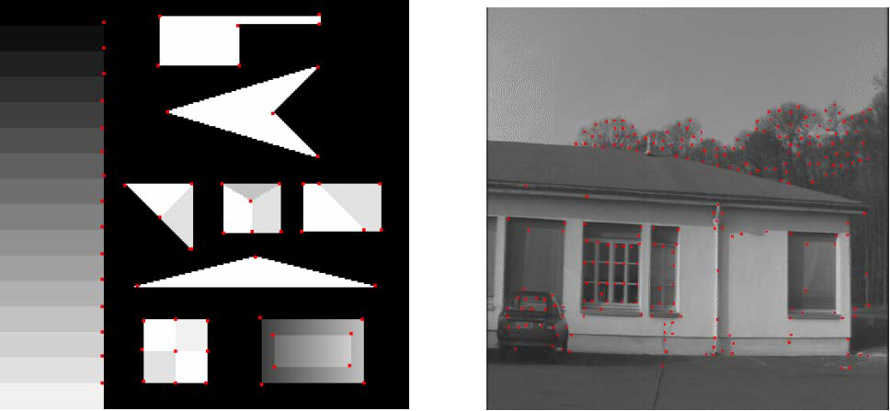
Synthetic & Real
Interest Points
Corners are indicated in red

Slide 7
Possible Approaches to
Corner Detection
Based on brightness of images
Usually image derivatives
Based on boundary extraction
First step edge detection
Curvature analysis of edges

Slide 8
Properties of Interest Point
Detectors
Detect all (or most) true interest points
No false interest points
Well localized.
Robust with respect to noise.
Efficient detection

Slide 9
Importance in Computer Vision
Image Matching and Registration: Identifying corresponding points between different images of the same scene, which is crucial for tasks like panorama stitching and 3D reconstruction.
Object Detection and Recognition: Recognizing objects within an image by matching their interest points to those of known objects

Slide 10
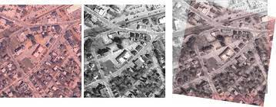
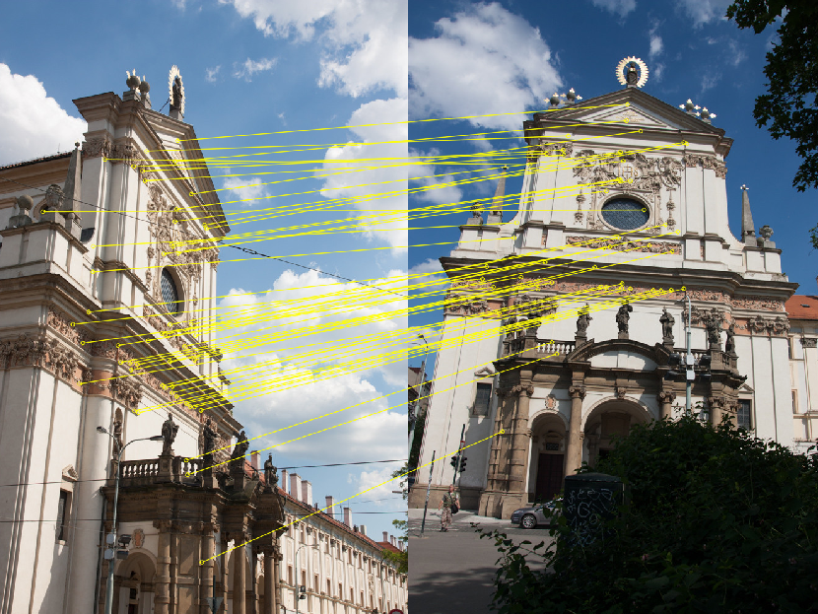

Slide 11
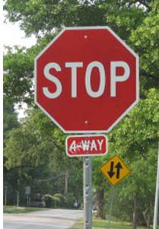
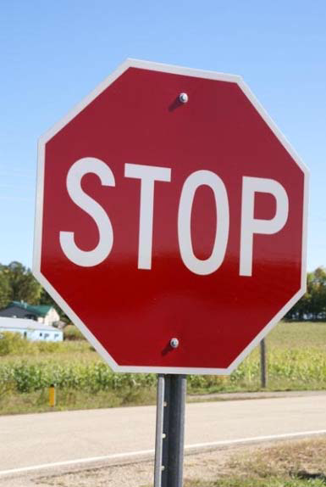




Correspondence across views
•Correspondence: matching points, patches,
edges, or regions across images
≈

Slide 12
Importance in Computer Vision
Motion Tracking: Tracking the movement of objects across a sequence of images by following the motion of interest points.
Structure from Motion (SfM): Reconstructing the 3D structure of a scene from multiple images by tracking interest points across those images.

Slide 13
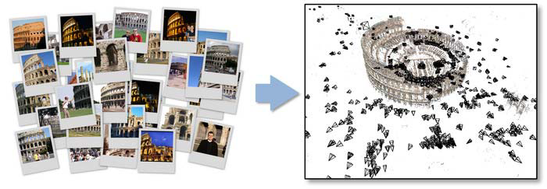
Example: structure from motion

Slide 14
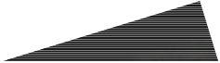




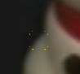
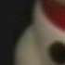

Overview of Keypoint Matching
1. Find a set of
distinctive key-
points
A₁
2. Define a region
around each
A_{2 A3}
keypoint
3. Extract and
normalize the
f_{A fB}
region content
4. Compute a local
descriptor from the
normalized region
5. Match local
d(f_{A},f_{B})<T
descriptors
K. Grauman, B. Leibe

Slide 15
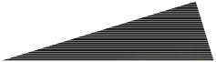

Goals for Keypoints
Detect points that are repeatableand distinctive

Slide 16
Goal: interest operator repeatability
•We want to detect (at least some of) the
same points in both images.
No chance to find true matches!
•Yet we have to be able to run the detection
procedure independentlyper image.
Kristen Grauman

Slide 17
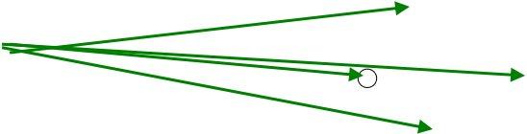
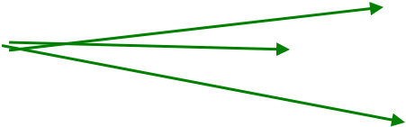
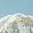
Goal: descriptor distinctiveness
•We want to be able to reliably determine
which point goes with which.
?
•Must provide some invarianceto geometric
and photometricdifferences between the two
views.
Kristen Grauman

Slide 18
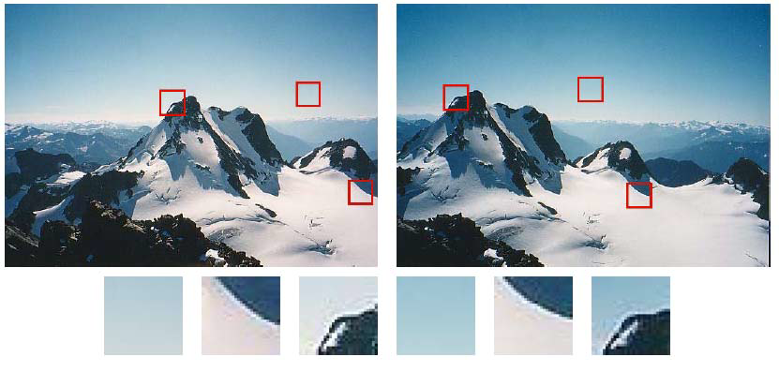
Some patches can be localized
or matched with higher accuracy than
others.

Slide 19
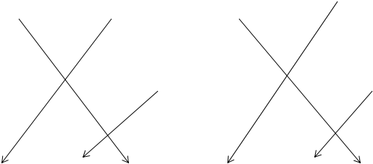
Some patches can be localized
or matched with higher accuracy than
others.

Slide 20
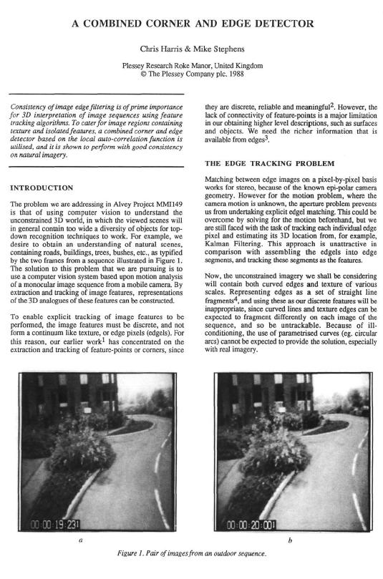
Harris Interest Point Detector
Cited by 8636

Slide 21
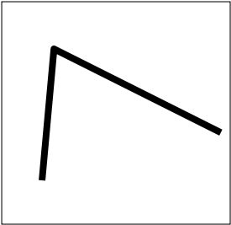

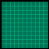
Harris Corner Detector
Corner point can be recognized in a window
Shifting a window in any direction should give
a large change in intensity
C.Harris, M.Stephens. “A Combined Corner and Edge Detector”. 1988

Slide 22

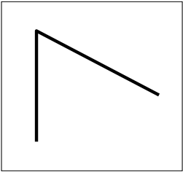















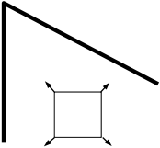















Basic Idea
“flat”region:
no change in
all directions
“edge”:
“corner”:
significant change
in all directions
no change along
the edge direction

Slide 23


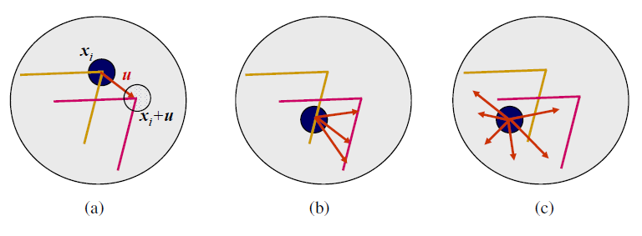
Aperture Problem

Slide 24
Aperture Problem

Slide 25
Correlation
⊗ =∑∑( )( )
f h fk,lhk,l
k l
f
=
Image
h
=
Kernel
f
h
= + +
f₁ f₂ f₃
f h fh fh fh
h₁ h₂ h₃
* 1 1 2 2 3 3
f₄ f₅ f₆
⊗
+ + +
h₄ h₅ h₆
fh fh fh
4 4 5 5 6 6
f₇ f₈ f₉
+ + +
h₇ h₈ h₉
fh fh fh
7 7 8 8 9 9

Slide 26
Correlation
⊗ =∑∑( )( )
f h fk,lhk,l ^{Cross correlation}
k l
⊗ =∑∑( )( )
f f fk,lfk,l ^{Auto correlation}
k l

Slide 27
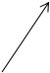
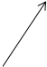
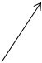
Correlation VsSSD
=∑∑((,)− (,))²
SSD fkl hkl ^{Sum of Squares Difference}
minimize
k l
=∑∑(( )− ( )( )+ ( ))
SSD fk,l² 2hk,lfk,l hk,l²
k l
=∑∑(− ( )( ))
minimize
SSD 2hk,lfk,l
These terms do not depend
on correlation
=∑∑( ( )( ))
k l
SSD 2hk,lfk,l
maximize
=∑∑(( )( ))
k l
Correlation hk,lfk,l
maximize
k l
⊗ =∑∑( )( )
f f fk,lfk,l
k l

Slide 28

Mathematics of Harris
Detector
Change of intensity for the shift (u,v)
=∑ + + −
Euv wxy Ix uy v Ixy
(, ) (, )[( , ) (, )]
2
  
xy
,
window function shifted intensity intensity
Auto-correlation

Slide 29
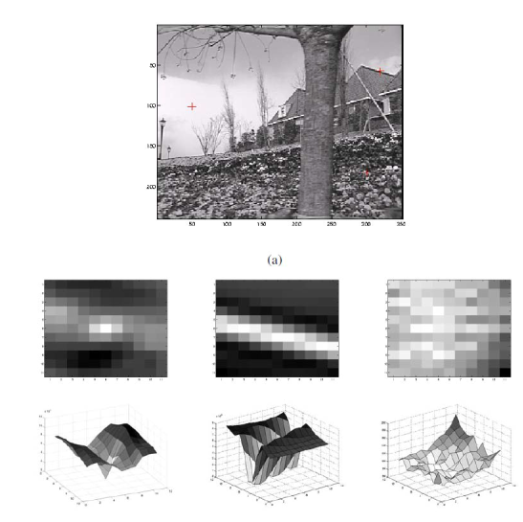
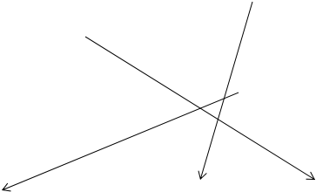
Auto-Correlation

Slide 30
Taylor Series
ƒ(x) Can be represented at point a in terms of its derivatives
( )
( )
2 3
f x =f a+x−af_{x}+ ^{x−a} f_{xx}+ ^{x−a} f_{xxx}+😐
() () ( )
2!
3!

Slide 31
Taylor Series
Express I(x+u,y+v) at (x,y):
I(x+u,y+v)=I(x,y)+I_{x}(x+u−x)+I_{y}(y+v−y)
I(x+u,y+v)=I(x,y)+I_{x}u+I_{y}v

Slide 32
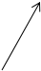
Mathematics of Harris
Detector
=∑ + + −
Euv Ix uy v Ixy
(, ) [( , ) (, )]
2
 
=∑ + + −
xy
,
shifted intensity intensity
Euv Ixy uI_{x} vI_{y} Ixy
Taylor Series
(, ) [(, ) (, )]
2
 
xy
,
shifted intensity ^{intensity}
=∑ +
Euv uI_{x} vI_{y}
(, ) [ ]²
xy
,
⎡
⎛
I
⎞
⎤
2
∑( )
⎜
⎟
⎡
II II
⎤
(, )
=
x
∑ ⎥
Euv u v
⎢
⎥
M
=
⎢
x x x y
⎢
⎝
I
⎠
⎥
⎣
⎦
II II
xy y
,
⎛
⎞
⎣
⎦
∑( ) ( ) ⎟
I
⎛
u
⎞
xy x y y y
(, )
=
⎜
x
⎟
I I
⎜
,
Euv u v
⎝
I
⎠
x y
⎝
v
⎠
xy
y
,
⎡
⎛
⎞
⎤
( ) ( ) ⎟
= ∑
I
⎛
u
⎞
⎛
u
⎞
Euv u v
⎜
x
⎟
I I
⎜
( ) ⎟
(, )
⎢
⎥
=
⎜
⎢
⎝
I
⎠
x y
⎥
⎝
v
⎠
E(u,v) u vM
⎣
xy
y
⎦
⎝
v
⎠
,

Slide 33
Mathematics of Harris
Detector
⎛
⎞
⎡
II II
⎤
E(u,v) u vM ∑ ⎥
u
( ) ⎟
M
=
x x x y
=
⎜
⎢
⎝
v
⎠
⎣
II II
⎦
xy x y y y
,
Let λ₁and λ₂be eigenvalues of M
According to Harris corner detection algorithm:
The corner response can be computed in terms of λ₁and λ_{2.}

Slide 34
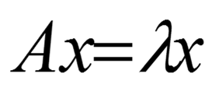
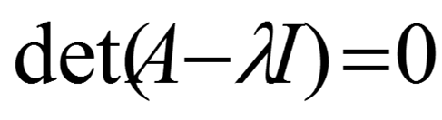
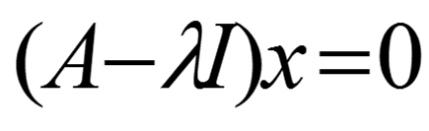
Eigen Vectors and Eigen Values
The eigen vector, x, of a matrix Ais a special vector, with
the following property
Where λis called eigen value
To find eigen values of a matrix A first find the roots of:
Then solve the following linear system for each eigen
value to find corresponding eigen vector

Slide 35
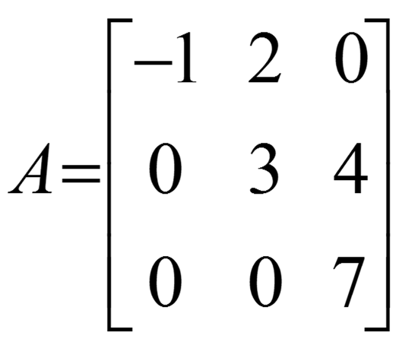
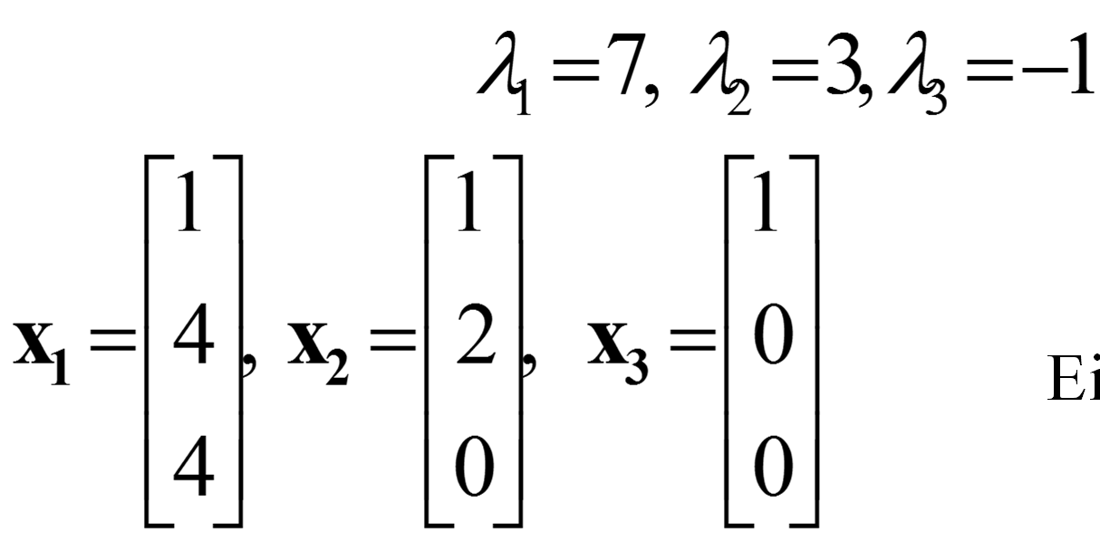
Example
Eigen Values
Eigen Vectors

Slide 36
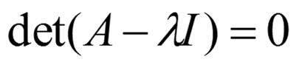
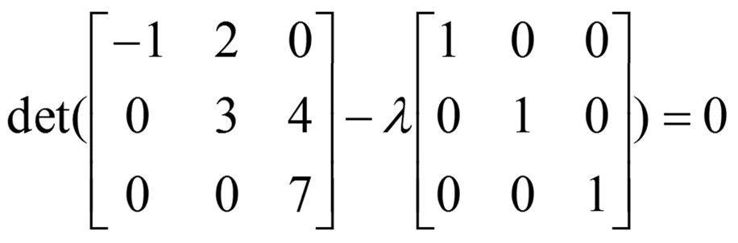
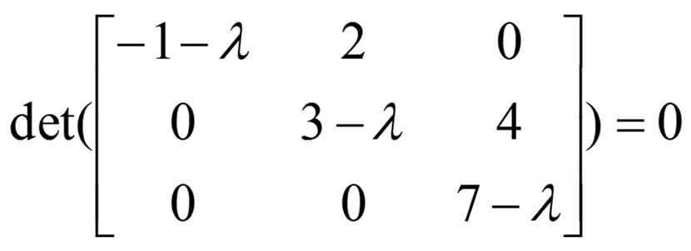
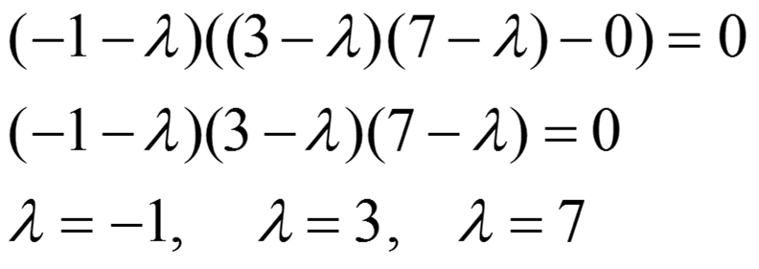
Eigen Values

Slide 37
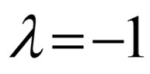
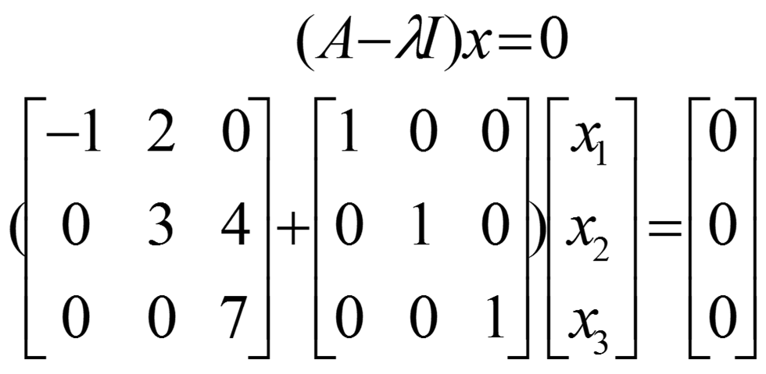
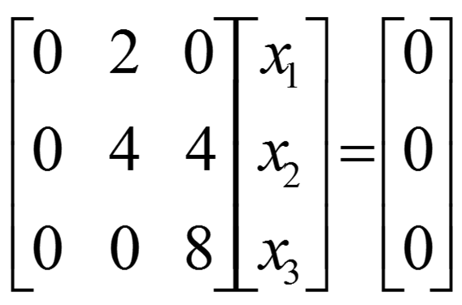
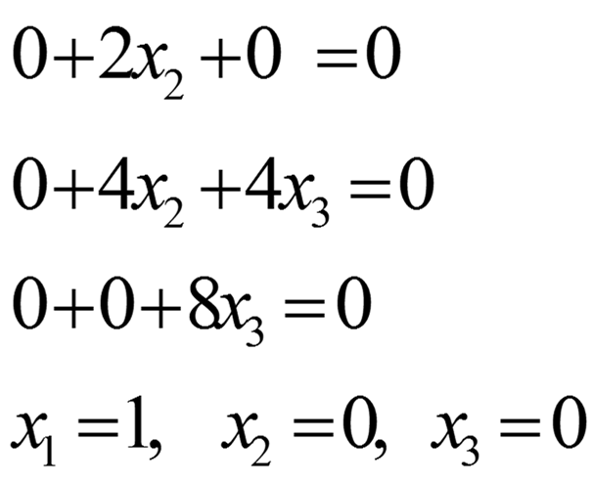
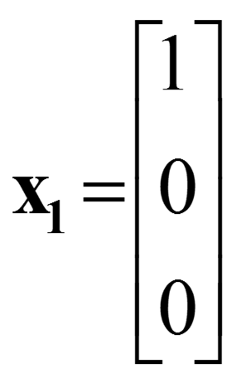
Eigen Vectors

Slide 38

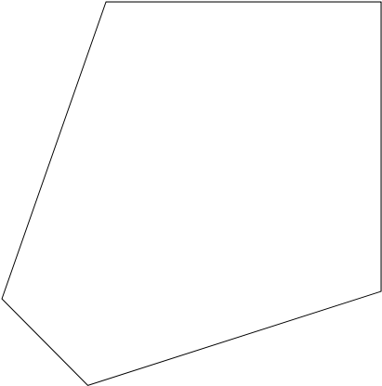
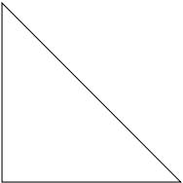
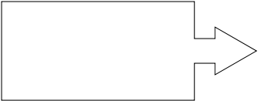

Mathematics of Harris
Detector
Classification of
image points using
eigenvalues of M:
λ₂
“Edge”
λ₂>> λ₁
“Corner”
λ₁and λ₂are large,
λ₁ ~ λ₂;
Eincreases in all
directions
λ₁and λ₂are small;
Eis almost constant
in all directions
“Flat”
region
“Edge”
λ₁>> λ₂
λ₁

Slide 39
Mathematics of Harris
Detector
Measure of cornerness in terms of λ₁, λ₂
⎡
λ
0
⎤
D
=
⎢
1
⎥
⎣
0
λ
⎦
2
R=detD−k(trace D)² R=λ₁λ₂−k(λ₁+λ₂)²

Slide 40
Mathematics of Harris
Detector
λ_{2 “Corner”}
“Edge”
•Rdepends only on
eigenvalues of M
R< 0
•Ris large for a corner
•Ris negative with large
magnitude for an edge
•|R| is small for a flat
region
R> 0
“Flat”
“Edge”
|R|small R< 0
λ₁

Slide 41



Slide 42

Compute corner response

Slide 43

Find points with large corner response: R> threshold
Find points with large corner response: R> threshold

Slide 44

Take only the points of local maxima of R
If pixel value is
greater than
its neighbors
then it is a local
maxima.

Slide 45


Slide 46
Other Version of Harris
Detectors
R=λ₁−αλ₂
Triggs
det( )
λλ
D
R
1 2
Szeliski (Harmonic mean)
⁼traceD ⁼ +
( )
λ λ
1 2
R=λ₁
Shi-Tomasi

Slide 47

Algorithm
■

Slide 48
import cv2
import numpy as np
def harris_corner_detection(image, blockSize=2, ksize=3, k=0.04):
"""
Implement Harris Corner Detection.
Parameters:
- image: Input image, grayscale.
- blockSize: The size of the neighbourhood considered for corner detection.
- ksize: Aperture parameter for the Sobel operator.
- k: Harris detector free parameter.
Returns:
- dst: Image with Harris corner response.
"""
# Convert image to grayscale if it is not already
if len(image.shape) == 3:
gray = cv2.cvtColor(image, cv2.COLOR_BGR2GRAY)
else:
gray = image
# Ensure the image is in float32 format
gray = np.float32(gray)
# Harris Corner Detection
dst = cv2.cornerHarris(gray, blockSize, ksize, k)
# Result is dilated for marking the corners
dst = cv2.dilate(dst, None)
print(type(dst), dst.max(), dst.min())
# Threshold for an optimal value, marking the corners in the input image
image[dst > 0.03 * dst.max()] = [0, 0, 255] # Mark corners in red
return image

Slide 49
# Load an image (make sure the path is correct)
image = cv2.imread('house.png')
# Perform Harris Corner Detection
corner_image = harris_corner_detection(image, blockSize=3, ksize=5, k=0.01)
# Display the image with detected corners
cv2.imshow('Harris Corners', corner_image)
cv2.waitKey(0)
cv2.destroyAllWindows()

Slide 50
Algorithm
■

Slide 51
Reading Material
Section 4.1.1 Feature Detectors
Richard Szeliski, "Computer Vision: Algorithms and Application“,
Springer.

